Slide 1

Methodology: Selecting Participants
AEPSY Year 11 ATAR Psychology

Slide 2
Review
What is the difference between an experimental research and an observational study?
What is the difference between a case study and a correlational study?
What is the difference between a longitudinal and a cross sectional study?
What methodology did Sperry’s Split Brain research follow?
Explain the limitations of a case study as a research methodology?

Slide 3
Learning Intentions
Selection of participants
identification of sample and population
methods to sample participants – application, method, strength and limitations
convenience sampling
snowballing
random sampling
stratified sampling

Slide 4
Success Criteria
Explain the difference between sample and population.
Compare application, method, strength and limitations of convenience sampling, snowballing, random sampling and stratified sampling.
Perform calculations based on stratified sampling.

Slide 5
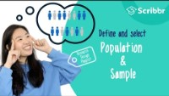

Slide 6
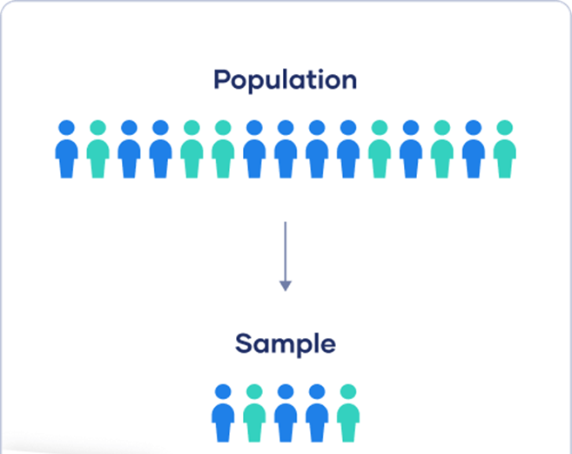
Population vs Sample
A population is the entire group that you want to draw conclusions about.
A sample is the specific group that you will collect data from. The size of the sample is always less than the total size of the population.

Slide 7
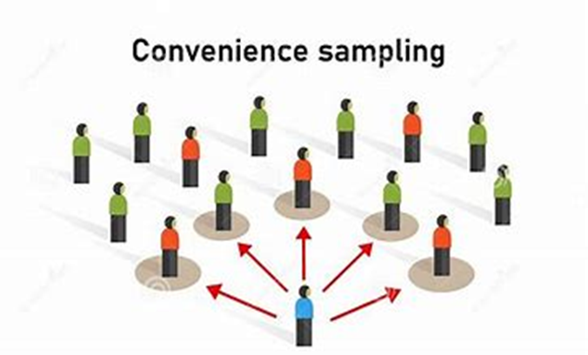
Convenience Sampling
Convenience sampling a is defined as a data collection method where you select the samples from a conveniently available pool of participants, eg standing at a shopping mall asking people to participate.

Slide 8
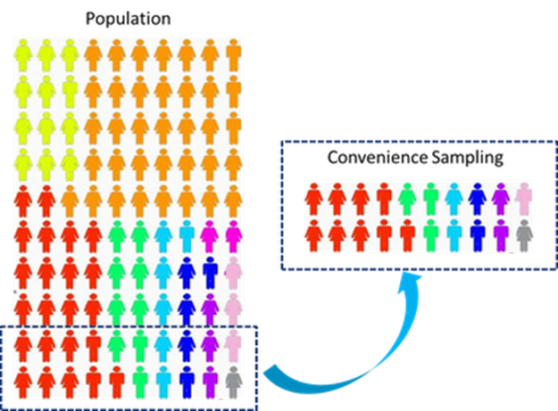
Convenience Sampling
Convenience sampling is easy, fast, and economical. It is very useful when a researcher decides to conduct a quick study.
It is prone to bias and not great for getting genuine representation of the population.

Slide 9
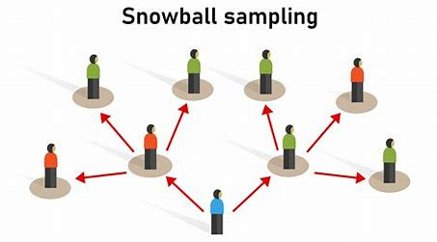
Snowballing
Snowball sampling is where new units are recruited by other units to form part of the sample. Snowball sampling can be a useful way to conduct research about people with specific traits who might otherwise be difficult to identify (e.g., people with a rare disease).

Slide 10
Snowballing
Snowball sampling can be a useful way to conduct research about people with specific traits who might otherwise be difficult to identify (e.g., people with a rare disease).
The sample is prone to bias and not representative of the entire population.

Slide 11
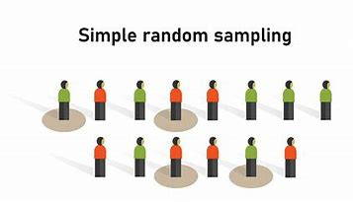
Random Sampling
A random sampling technique is when each member of the target population has an equal chance of being recruited to partake in the experiment.

Slide 12
Random Sampling
Less prone to bias, as a large random sample should be representative of the whole population.
This is only effective if the population and sample are relatively homogenous, and it can be difficult to gather a truly random sample.

Slide 13
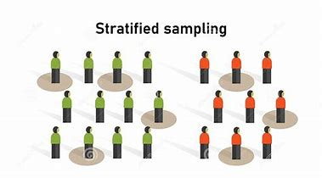
Stratified sampling
Stratified random sampling is a method of sampling that involves the division of a population into smaller subgroups known as strata. In stratified random sampling, or stratification, the strata are formed based on members’ shared attributes or characteristics, such as income or educational attainment.

Slide 14
Stratified Sampling
Reduces bias as the sample is more truly representative of the population.
It is more expensive, time consuming and difficult to access participants and initial research needs to be conducted to determine the subgroups and their frequency in the population.

Slide 15
Success Criteria
Explain the difference between sample and population.
Compare application, method, strength and limitations of convenience sampling, snowballing, random sampling and stratified sampling.
Perform calculations based on stratified sampling.

